Slide 2
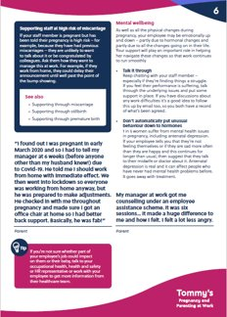
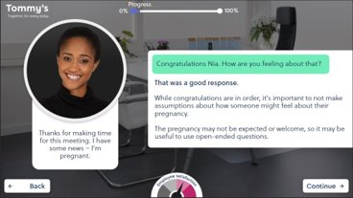
Expert-led training to help you navigate conversations around pregnancy and baby loss
Humber Teaching NHS Foundation Trust are a proud member of Tommy's Pregnancy and Parenting
at Work programme which provides us with all the guidance needed to support
our employees through any pregnancy journey, from planning and parenting
to complications and loss.
As an employee you will have access to:
1) Two interactive e-learning courses covering:
Pregnancy and parenting at work
Supporting an employee through pregnancy and baby loss or premature birth
2) Toolkit of additional resources, including written guides covering:
Good communication, fertility treatment, surrogacy, adoption, partners and more
3) Direct access to Tommy’s midwives for all employees:
Email midwife@tommys.org or call 0800 014 7800

Slide 3
Why should you take the Pregnancy and Parenting at Work training?
Right now, 1 in 4 of your colleagues will lose a baby during pregnancy or birth
We know it’s hard to know what to say or do to support a colleague, but saying nothing is what hurts the most
Have you ever been worried about saying the wrong thing or not knowing what to say to a colleague who has experienced baby loss?
By completing Pregnancy and Parenting at Work, you’ll have better understanding and awareness of the impact of baby loss within the workplace, helping us to create a space for open conversation around pregnancy loss within our organisation.
Start your training today to help us ensure that your colleagues receive the best possible support, no matter their journey to parenthood.

Slide 4
Our partnership with Tommy’s
The UK’s leading pregnancy research charity, Tommy’s refuse to accept that 1 in 4 pregnancies end in loss or premature birth and are dedicated to finding causes and treatments to save babies’ lives as well as providing trusted expert information and support.
We’ve partnered with Tommy’s to help support our employees through any pregnancy journey, from planning and parenting to complications and loss.
As a member of Tommy’s Pregnancy and Parenting at Work programme, we are committed to providing comprehensive support for our employees as well as promoting more open and meaningful conversations around pregnancy and parenting in the workplace.
We want to ensure that the best possible support is put into place which gives our employees the reassurance they will be cared for, no matter where they are on their pregnancy journey or what their experience entails.

Slide 5
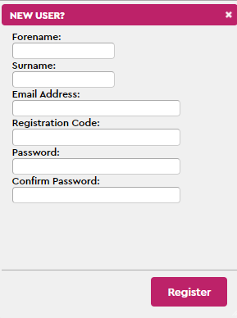
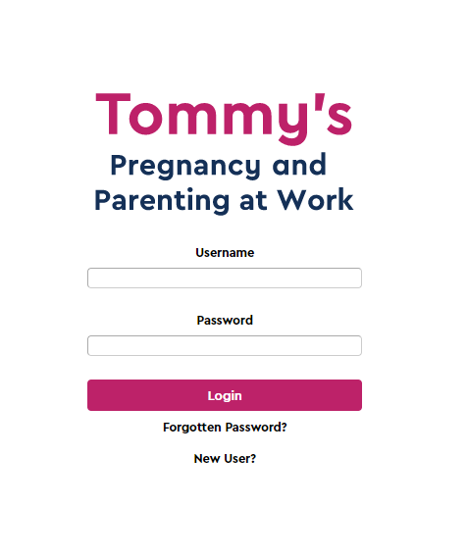
Accessing your Tommy’s Portal
Scan the QR code:
Or visit https://work.tommys.org/login
2) Click 'New User' and a box like this should appear. Enter the required details.
3) Type in your organisation’s unique registration code:
4) Click ‘Register’ to start your training
REG CODE: HUMBER2023

